Slide 1
Computer systems information
User Guide to R&D systems

Slide 2

Emotional Connection
Emotional connection is key
The right connection inspires brand loyalty
It’s time to break new ground
Notes:
Emotional connection is key
Research shows that virtually all strong opinions on packaging for our products and those of competitors are emotion-based
The right connection inspires brand loyalty
Change brand perception by getting personal
It’s about the person, not the package
Breaking new ground
Every aspect of the package should have a purpose
We need to get better about making choices

Slide 3
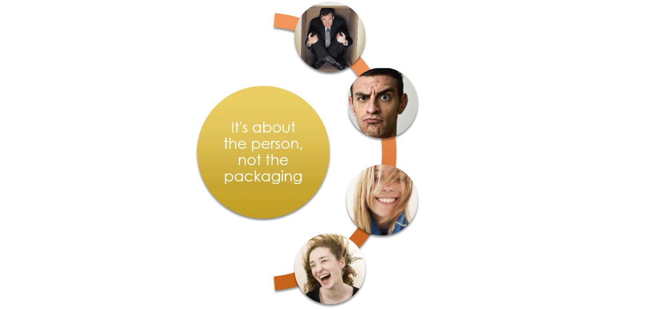
Fit the person—not the Box

Slide 4
Design considerations
What Creates a Connection?
Notes:
What attracts the person to the package?
Shape and color were the clear winners in focus group testing

Slide 5
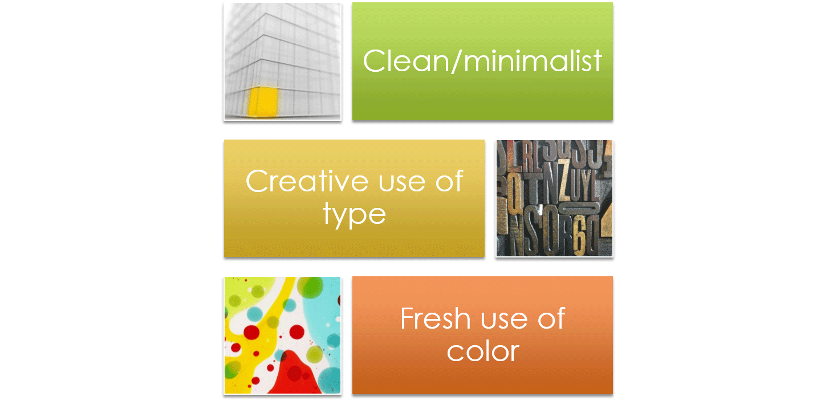
Current trends

Slide 6
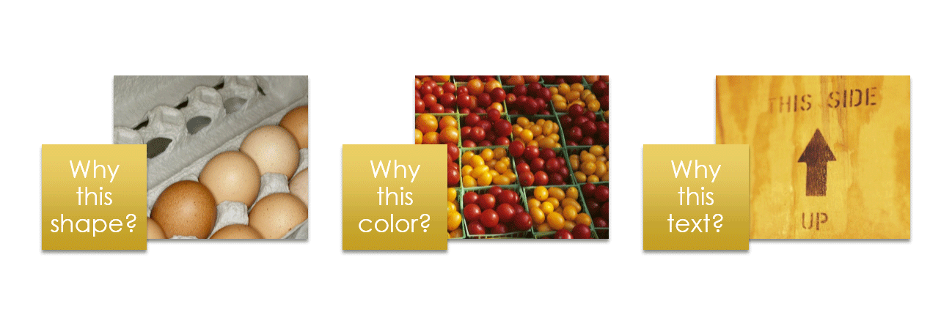
Making Choices
Shape, color, and content are all important
The key is to be selective and make effective choices
Every element must serve a purpose
Notes:
The shape of an egg box protects its content. But it’s also iconic; instantly recognizable for what it is.
Color should be as integral to a product package as the color of a fruit or vegetable. What does the color tell you about what’s inside?
No matter how well written, a package is not like a novel; nobody wants to read it over coffee. Be concise, and be relevant. Every word should serve a purpose.

